Slide 1
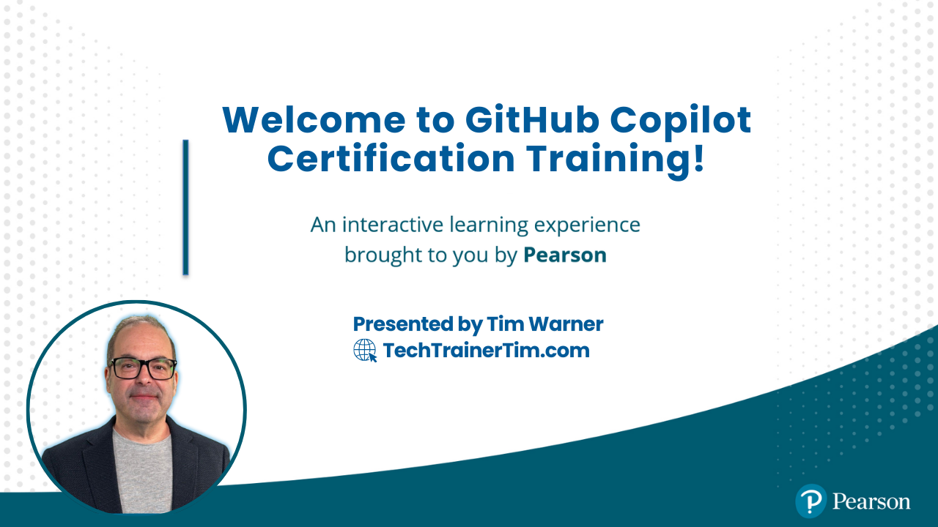
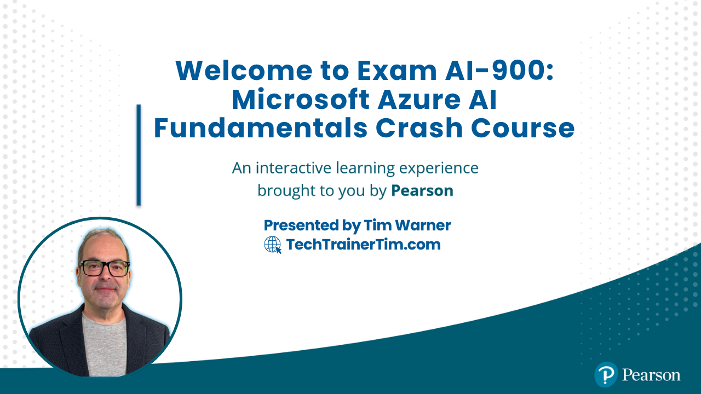
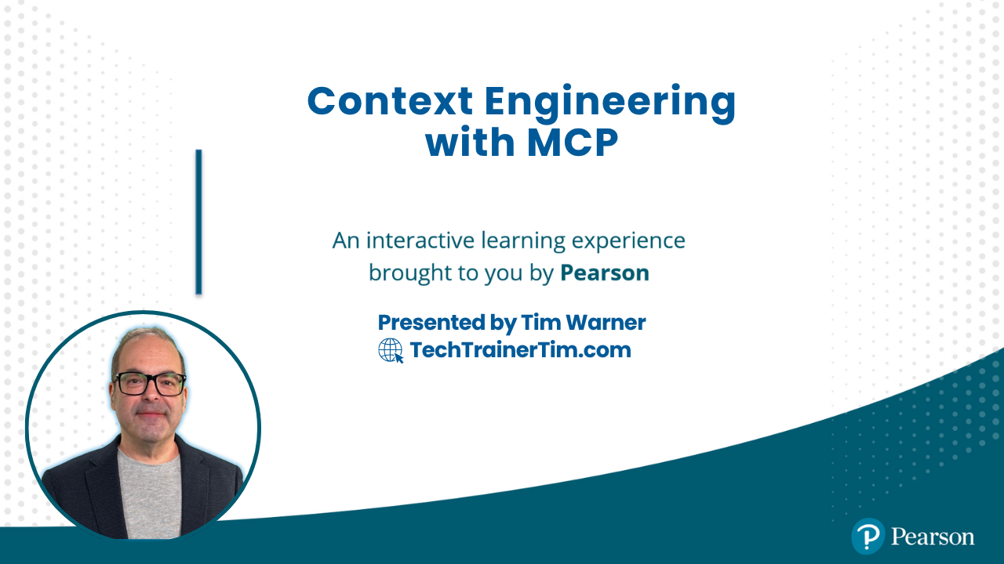
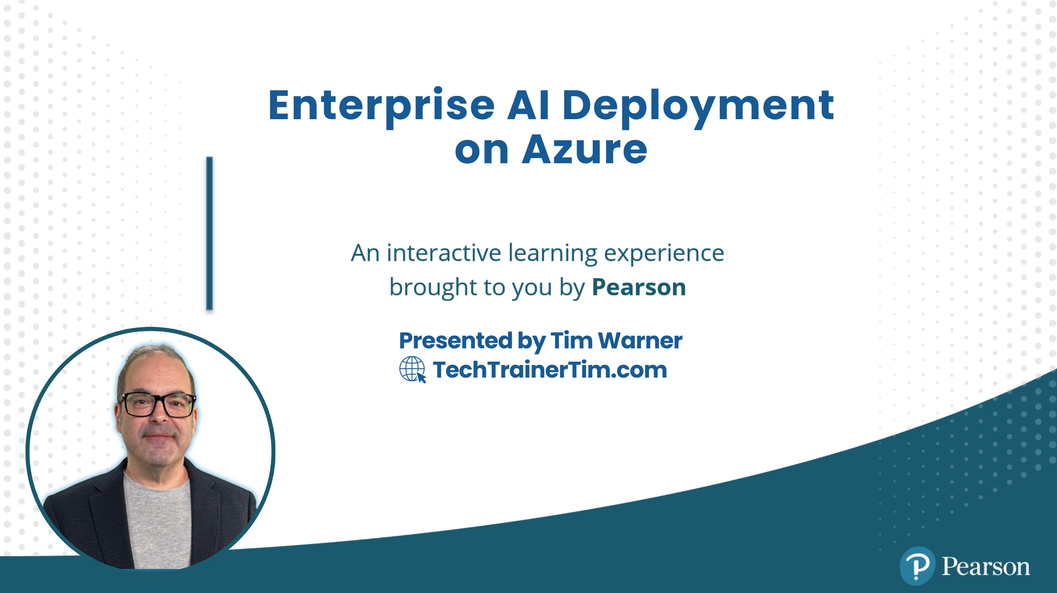




GitHub Copilot for Almost Everyone
Tim Warner
timw.info/linkedin
Notes:
How much flexibility am I allowed with these slide layouts? If you right-click a slide, you can play with layouts, but otherwise, not much flexibility.
Am I free to add my own graphics, providing MSFT attribution where necessary? When it comes to MS graphics, we're not allowed to use those, so please do not add in graphics unless they are created FROM SCRATCH by you.
Can I make the font a bit smaller? Some of the objectives are verbose and I don’t want to crowd the skills? Yes, I do this, too, when I review the slides because sometimes the default size just won't work.
Do the bullet points here need to be word-for-word from the outline or can I condense? We prefer word-for-word, but some of the sub-lesson titles are super long. Use your discretion, and we can address case-by-case during the review of each lesson's slides.

Slide 2

Tim Warner
Based in Nashville, TN, US
Microsoft tech specialist and trainer since 1997 (Windows NT 4.0)
Microsoft Certified Trainer (MCT)
Microsoft MVP in Azure AI & Cloud/Datacenter Management
Contact: TechTrainerTim.com

Slide 3
Course Flow (Central Time Zone)
11:00 am - Segment 1 [Understanding Context]
12:00 pm - 10-min break - Segment 2 [Build Local MCP]
01:00 pm - 10-min break - Segment 3 [Build Remote MCP]
02:00 pm - 10-min break - Segment 4 [Future Trends]
03:00 pm - Finish

Slide 4
Course materials
timothywarner-org/copilot-memory-store

Slide 5
🔤 How AI Reads Your Prompts
Understanding Tokenization for Better MCP Context
O'Reilly Learning Platform

Slide 6
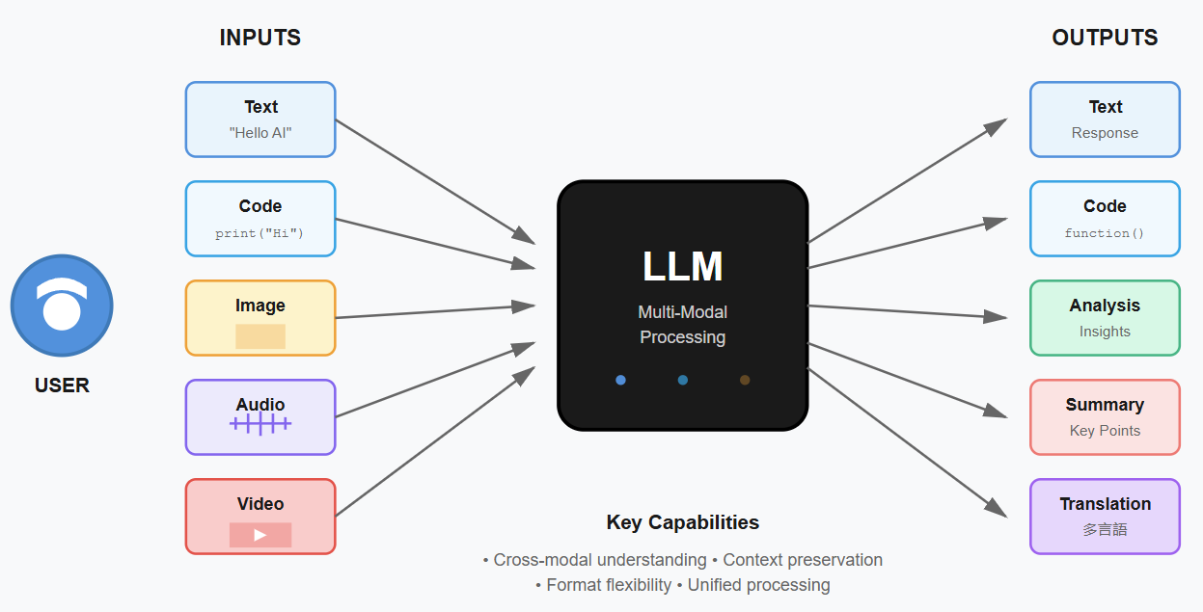
LLM Multi-Modal Processing
Notes:
Image credit: Tim + Claude AI

Slide 7
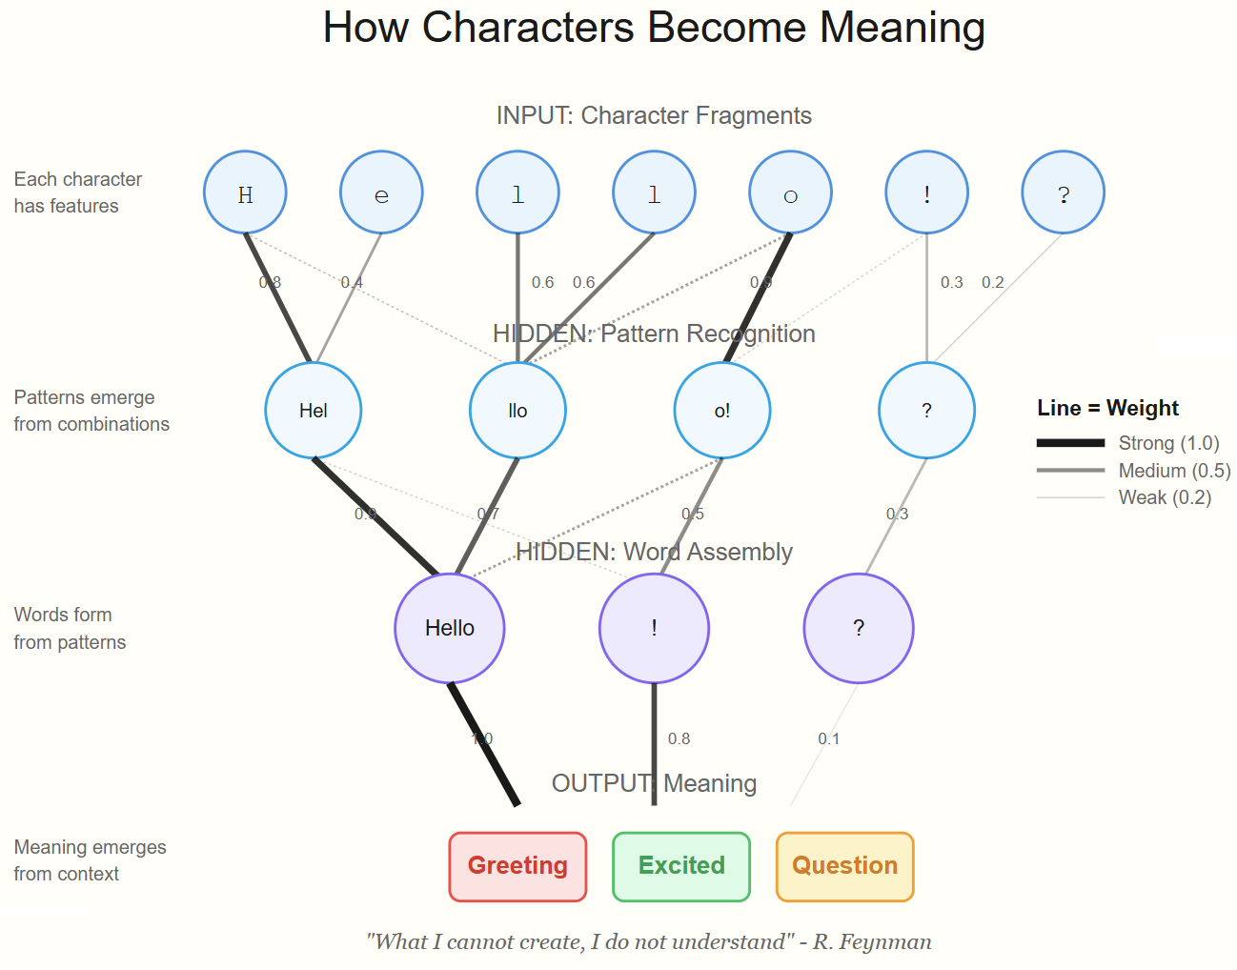
Neural Network
Notes:
Image credit: Tim + Claude AI

Slide 8
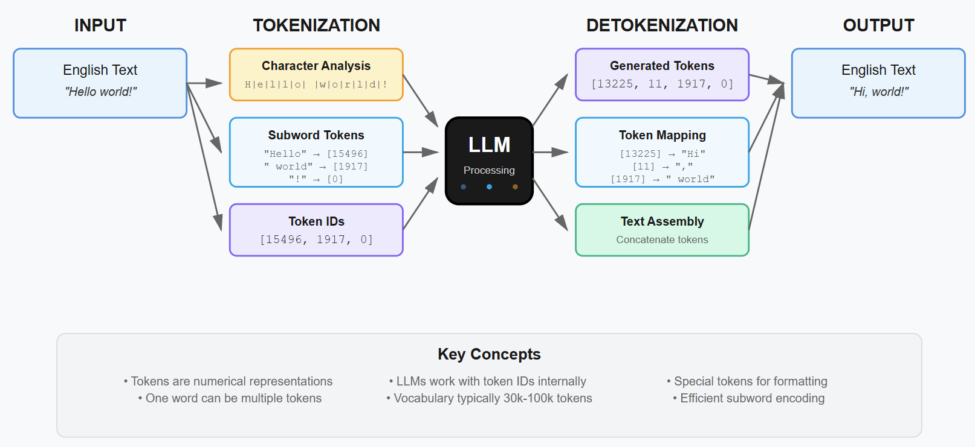
Tokenization Process in LLMs

Slide 9

Context Length

Slide 10
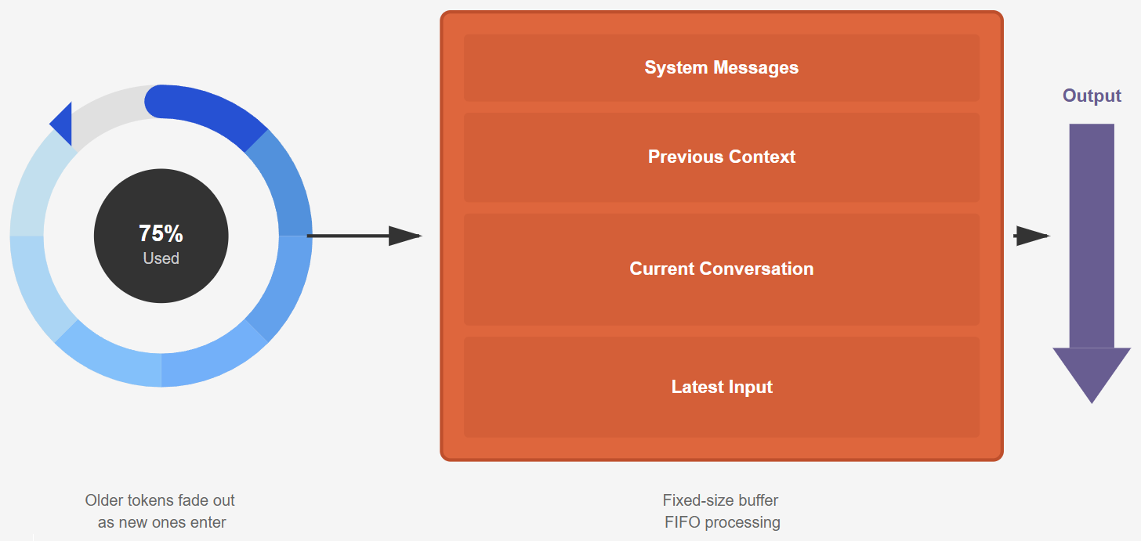
Context Window
Notes:
Illustration credit: Tim

Slide 11
Step 1: Breaking Text into Chunks (Tokens)
What You Type
AI Breaks It Down
What AI Sees
"Context engineering improves AI"
Splits into meaningful pieces
(like puzzle pieces)
["Context", " engineering",
" improves", " AI"]
→
→

Slide 12
Three Types of AI Memory Systems
📚
💡
⚡
Episodic Memory
Semantic Memory
Working Memory
What Happened
What I Know
What I'm Doing
Stores time-ordered conversation history and events
Stores facts, knowledge, and learned information
Manages active tasks and current context
Use Cases:
Use Cases:
Use Cases:
• Chat history
• User interactions
• Session logs
• Audit trails
• Documentation
• FAQs
• Domain knowledge
• Best practices
• Current task state
• Open files/tools
• Active prompts
• Session context
Technology:
Technology:
Technology:
Azure Cosmos DB
Time-series storage
Vector databases
Azure AI Search
Redis Cache
In-memory state

Slide 13
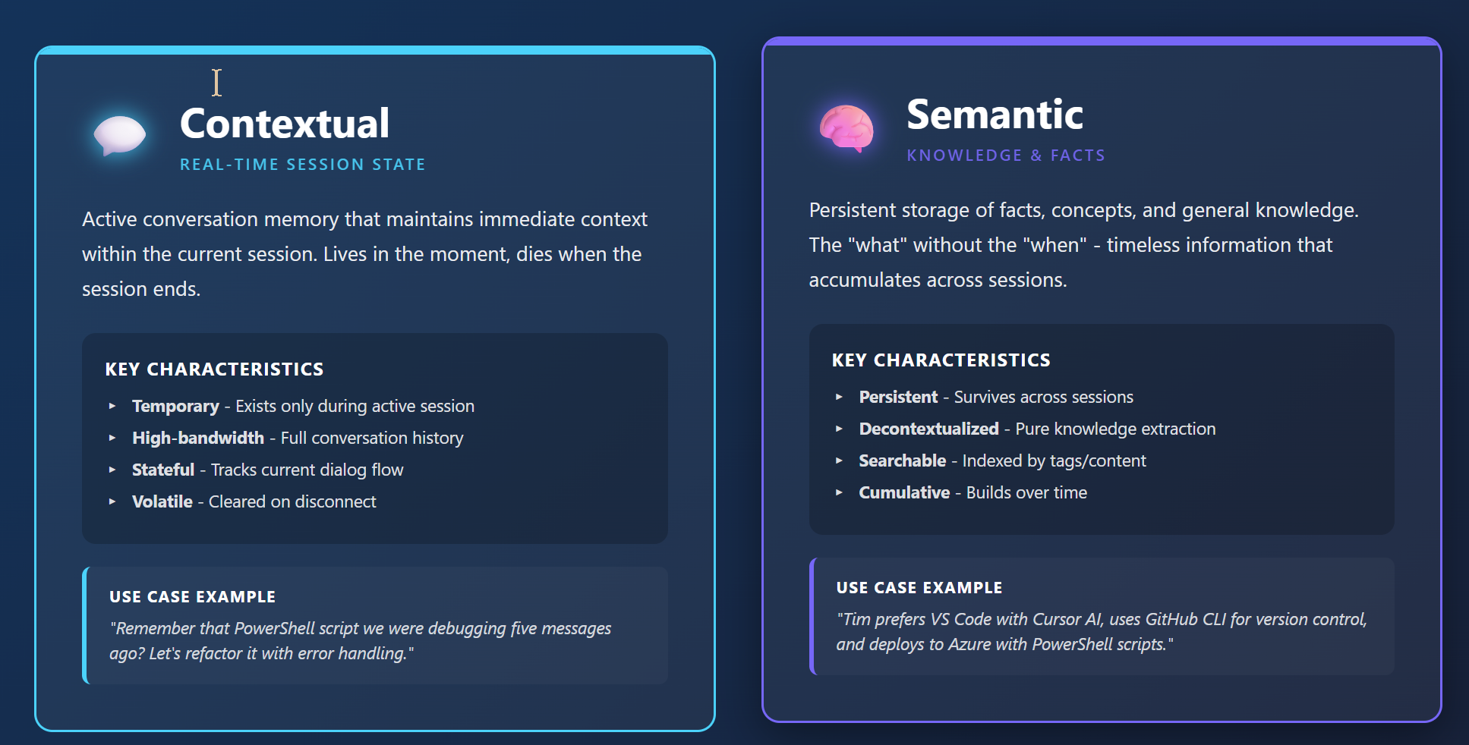
MCP Memory Types

Slide 14
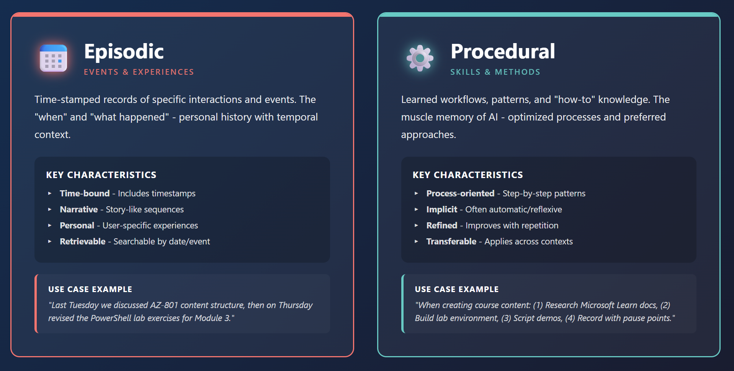
MCP Memory Types

Slide 15
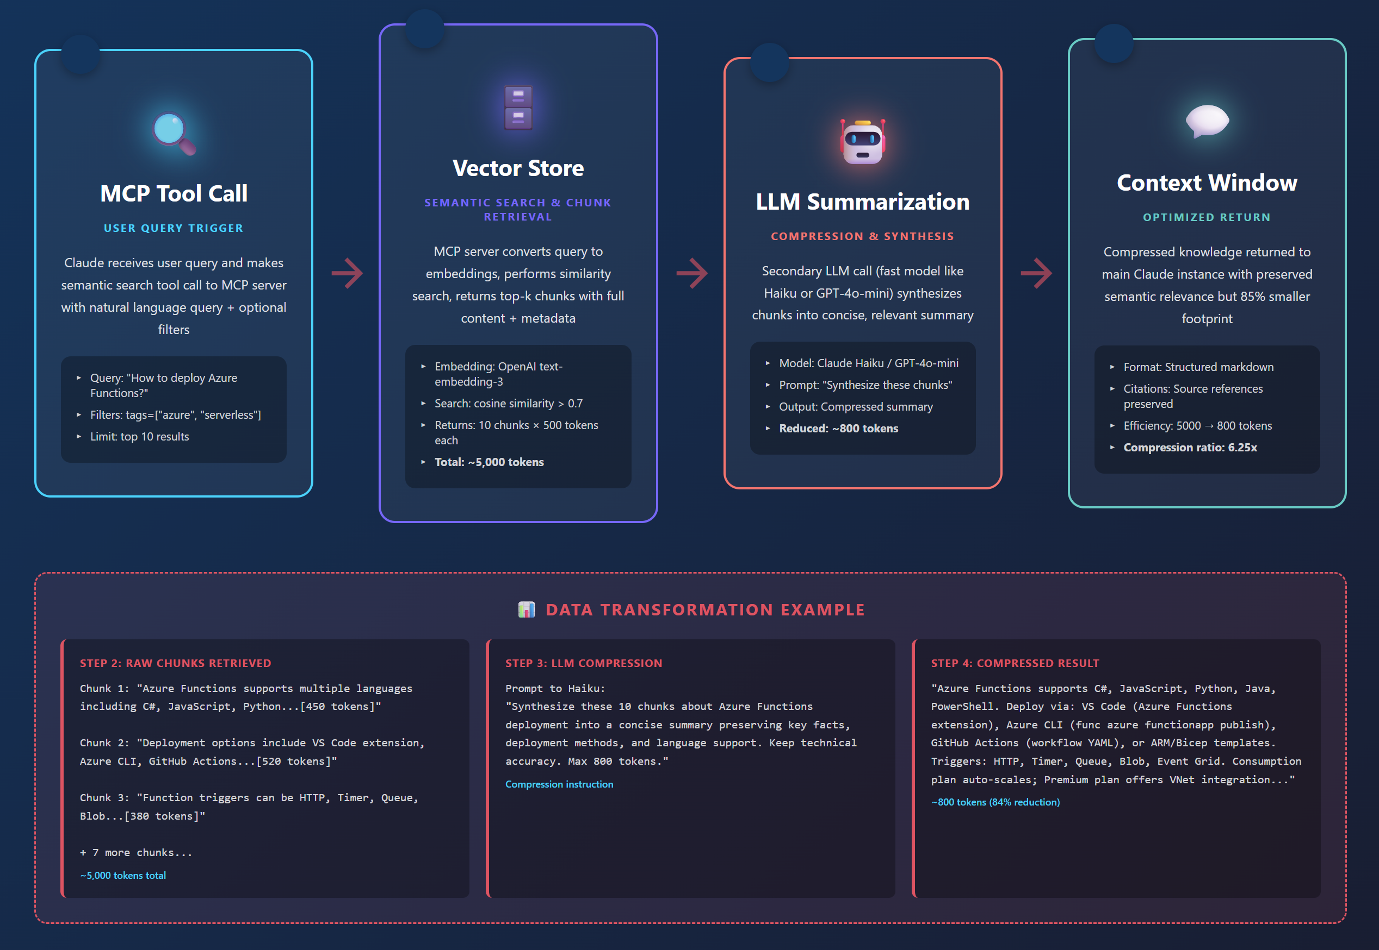
MCP Semantic Compression Pattern

Slide 16
Context Injection: The Complete Pipeline
👤
STEP 1
STEP 2
STEP 3
STEP 5
🤖
💬
→
SELECT
→
COMPRESS
→
ASSEMBLE
→
→
WRITE
→
User Query
LLM
Response
Retrieve memories
Summarize history
Build context
Store to memory
THE ASSEMBLED CONTEXT WINDOW
System Prompt
Injected Memories
History (Compressed)
Tool Definitions
Current Query
Role, capabilities, constraints
Facts, preferences, past context
Recent turns, summarized older
Dynamically selected
User's actual request
Key Insight: Every LLM call is stateless. The "memory" comes from what YOU inject into the context window.
Cognizant Engineer Training • Context Engineering
Notes:
This is the complete pipeline - context injection in action. User query arrives. We SELECT relevant memories from external storage. We COMPRESS the conversation history if it exceeds our budget. We ASSEMBLE everything into the final context window. The LLM processes it. Then we WRITE the interaction back to memory for future use. Notice how every LLM call is stateless. The "memory" is entirely constructed by your context engineering layer.

Slide 17
Step 2: AI Reads in Both Directions Simultaneously
"Context"
" engineering"
" improves"
" AI"
[END]
Chunk #1
Chunk #2
Chunk #3
Chunk #4
Done
← Looks Backward
Looks Forward →
Each chunk connects to every other chunk at once,
so AI understands the full meaning from all directions

Slide 18
Why This Matters for Your MCP Work
💰
🔄
📏
Cost & Speed
Full Context Reading
Memory Limit
More tokens = higher cost and slower responses. Keep prompts concise.
Modern AI sees your entire message at once for better understanding.
Claude holds ~200K chunks. Strategic placement matters for quality.
🎯
🧩
📍
Position Matters
Word Breaking
Structure Prompts
Put critical info at beginning or end—AI pays more attention there.
Unknown words split into pieces. "TechTrainerTim" → ["Tech", "Trainer", "Tim"]
Use clear sections, headers, bullets to help AI find information faster.

Slide 19
Practical Tips for Better AI Prompts
• Put important stuff first: AI pays closest attention to the beginning
• Use clear section breaks: Headers, bullets, and whitespace help AI organize
• Watch your word count: Longer isn't always better—be concise and specific
• Repeat key terms: If something matters, mention it multiple times
• Test and iterate: Try different phrasings to see what gets better results

Slide 20
🔗 Model Context Protocol (MCP)
Connecting AI to Your World
O'Reilly Learning Platform

Slide 21
How MCP Works: The Three-Layer Architecture
🤖
⚙️
💾
AI Host
MCP Server
Your Resources
Your AI application that needs
access to data and tools
→
Translator that speaks both
AI and your tools' languages
→
Databases, files, APIs you
want AI to access
Claude Desktop, VS Code
Handles requests
Notion, GitHub, Filesystem

Slide 22
📨 The Communication Flow
1
2
3
4
Request
Translate
Fetch
Deliver
→
→
→
AI asks: "Show me my
Notion docs about MCP"
MCP Server converts
to Notion API format
Server retrieves data
from Notion workspace
AI receives clean,
structured data

Slide 23
🎯 Why MCP Changes Everything
🔌
🔒
⚡
Universal Standard
Security First
Real-Time Access
One protocol works with any AI
and any data source
Your data stays on your systems.
AI only sees what you permit
AI works with live data,
not outdated snapshots
🧩
📈
🛠️
Composable
Scales Easily
Developer Friendly
Mix and match multiple servers
for custom workflows
Add new data sources without
rebuilding infrastructure
Build once, deploy anywhere.
Works across all AI hosts

Slide 24
🚀 Real-World Applications
📝 Knowledge Management
💻 Development Workflow
Connect AI to Notion, Confluence, or SharePoint to search and create docs
Link AI to GitHub to read code, create PRs, and manage issues
"Find all meeting notes from Q4 mentioning Azure costs"
"Review my PR #342 and suggest performance improvements"
📊 Data Analysis
🎬 Content Creation
Connect databases and spreadsheets to query data through natural language
Integrate scripts, outlines, and media libraries for content pipeline
"Show me subscriber growth trends for the past 6 months"
"Create outline for my AZ-801 module 3 based on existing notes"

Slide 25
🚀 Building Your First MCP Server
Hello World with Node.js: stdio & HTTP Transport
O'Reilly Learning Platform

Slide 26
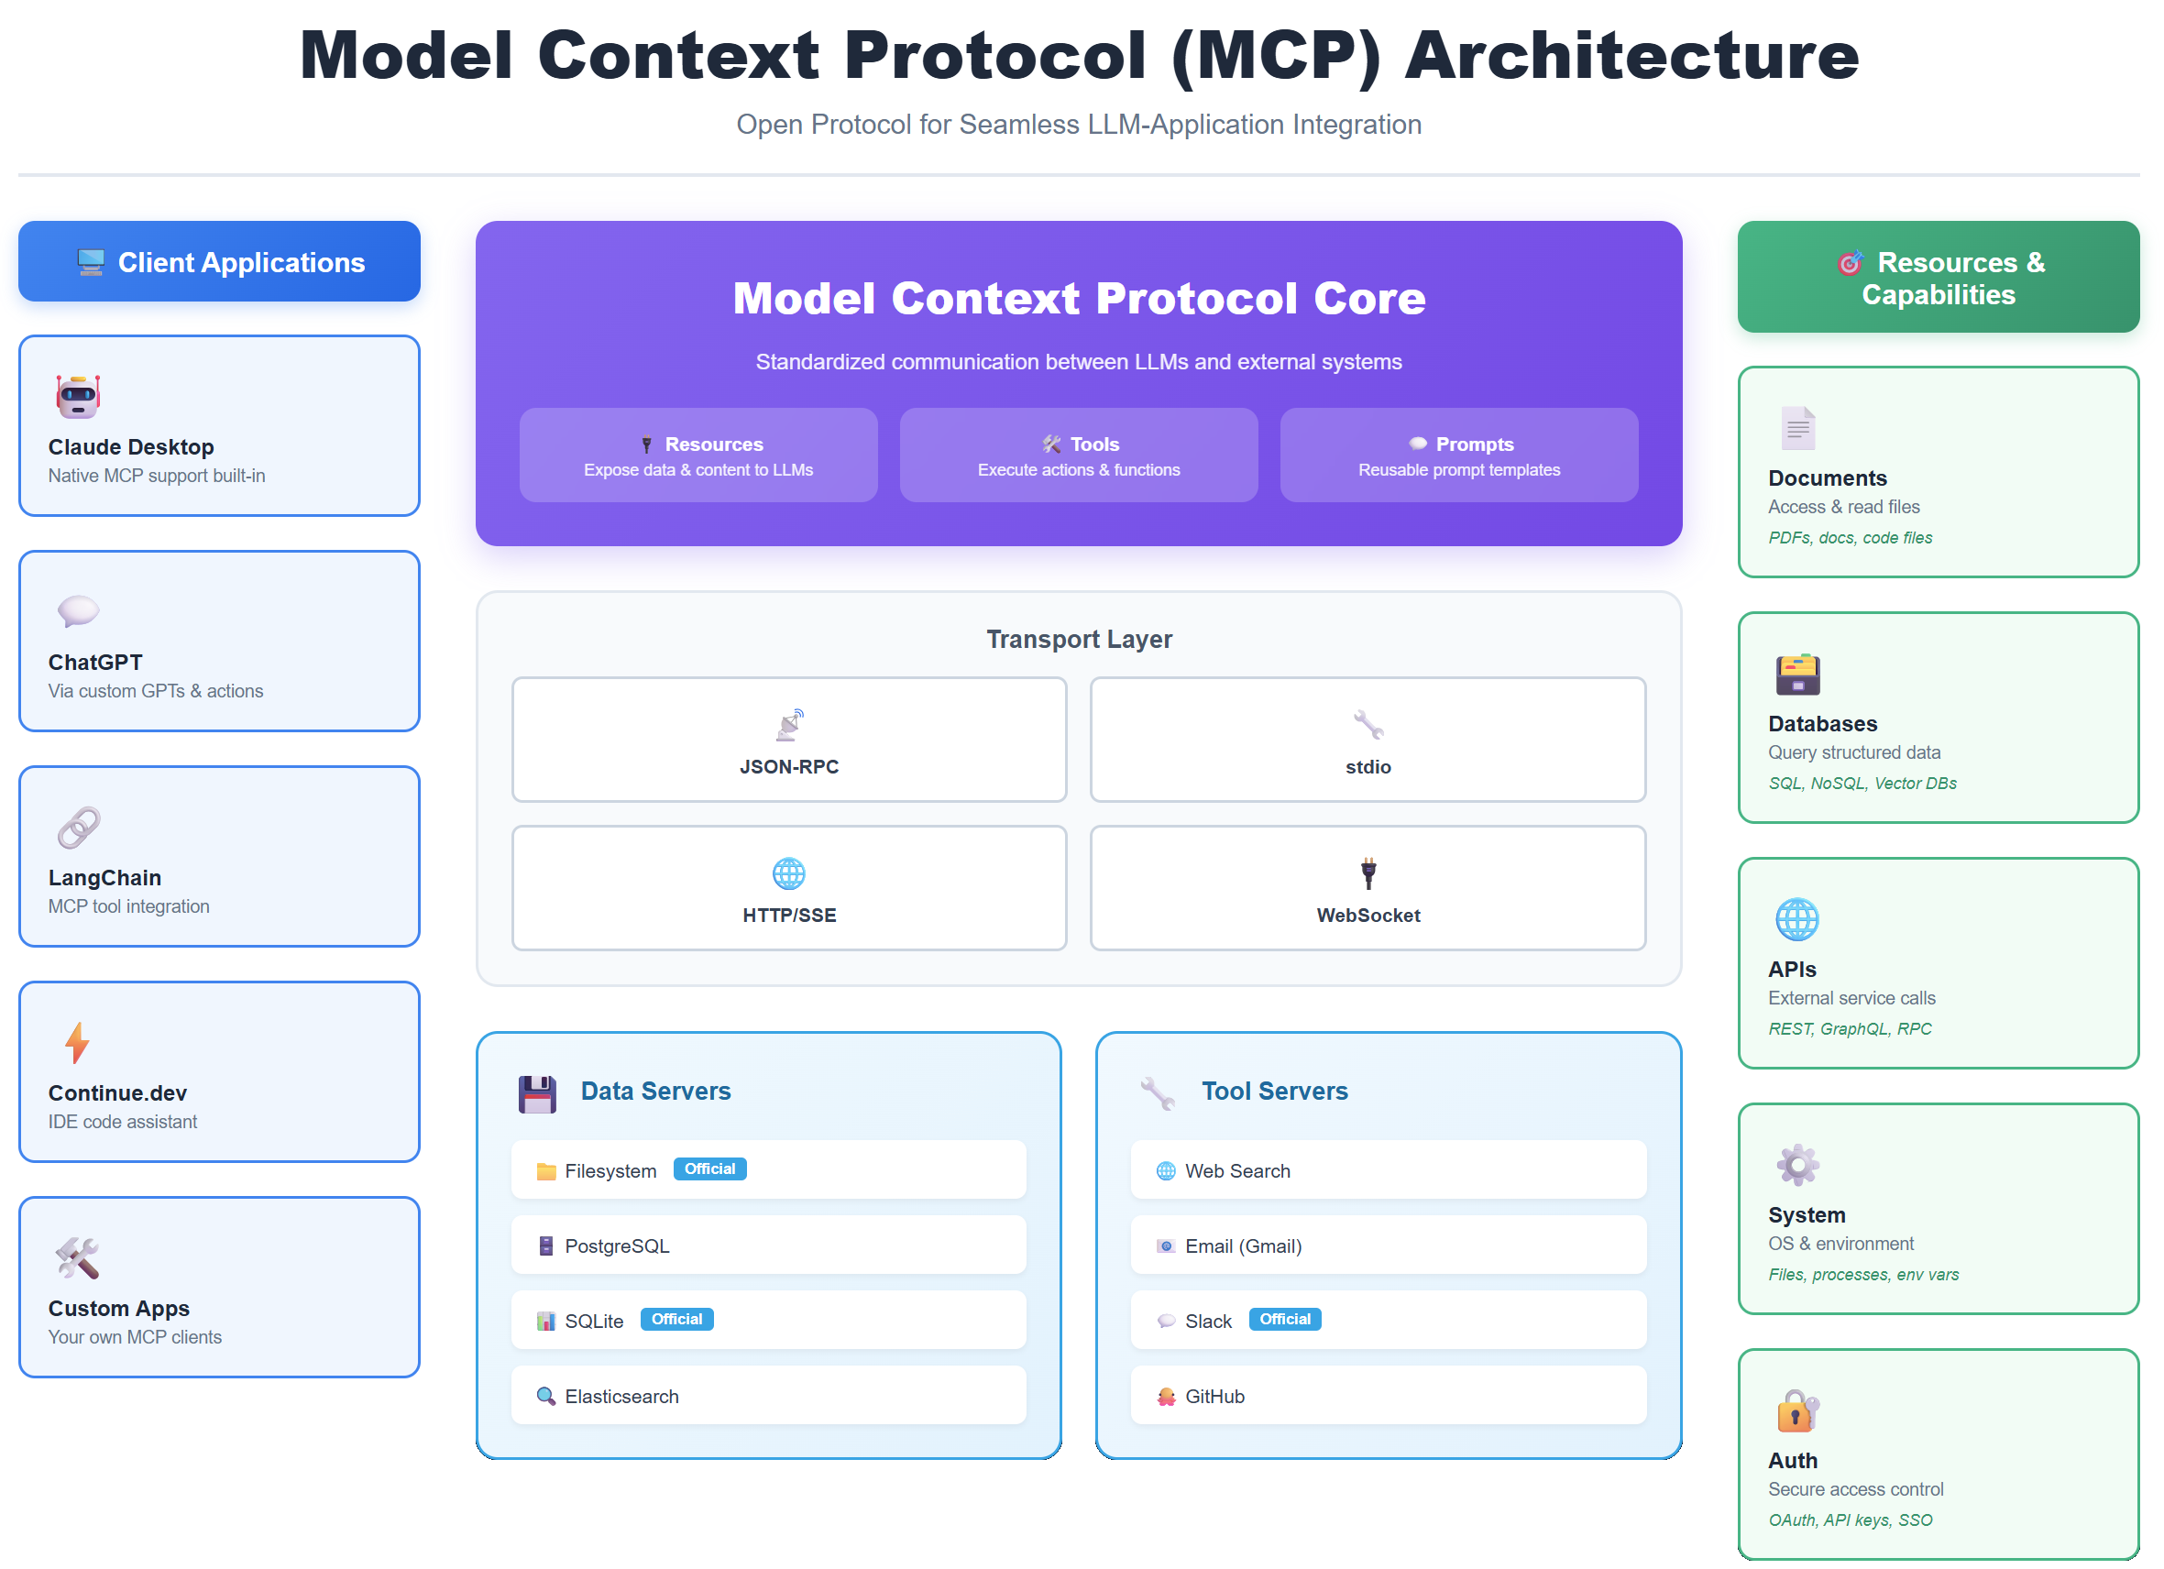

Slide 27
What We're Building Today
A complete 'Hello World' MCP server with two transport methods (stdio + HTTP), one tool (echo), and one resource (greeting message). We'll configure it for local testing with Claude Desktop.
📦
🔧
📄
⚙️
Two Transports
One Tool
One Resource
Full Config
stdio (process)
HTTP (network)
echo command
returns your text
greeting.txt
welcome message
Claude Desktop
setup included

Slide 28
Step 1: Project Setup
1
Create project directory
$ mkdir hello-mcp-server && cd hello-mcp-server
2
Initialize npm project
$ npm init -y
3
Install MCP SDK
$ npm install @modelcontextprotocol/sdk
4
Install dependencies
$ npm install express

Slide 29
Step 2: Server Code - Imports & Server Setup
// server.js
import { Server } from "@modelcontextprotocol/sdk/server/index.js";
import { StdioServerTransport } from "@modelcontextprotocol/sdk/server/stdio.js";
import { SSEServerTransport } from "@modelcontextprotocol/sdk/server/sse.js";
import express from "express";
// Create MCP server instance
const server = new Server(
{
name: "hello-world-mcp",
version: "1.0.0",
},
{
capabilities: {
tools: {}, // Support tools
resources: {}, // Support resources
},
}
);

Slide 30
Step 3: Define the Tool - Echo Command
// Define available tools
server.setRequestHandler("tools/list", async () => {
return {
tools: [
{
name: "echo",
description: "Echoes back the message you send",
inputSchema: {
type: "object",
properties: {
message: {
type: "string",
description: "The message to echo back",
},
},
required: ["message"],
},
},
],
};
});
// Handle tool execution
server.setRequestHandler("tools/call", async (request) => {
if (request.params.name === "echo") {
const message = request.params.arguments.message;
return {
content: [
{
type: "text",
text: `Echo: ${message}`,
},
],
};
}
throw new Error(`Unknown tool: ${request.params.name}`);
});

Slide 31
Step 4: Define the Resource - Greeting Message
// Define available resources
server.setRequestHandler("resources/list", async () => {
return {
resources: [
{
uri: "greeting://hello",
name: "Hello World Greeting",
description: "A simple greeting message",
mimeType: "text/plain",
},
],
};
});
// Handle resource reading
server.setRequestHandler("resources/read", async (request) => {
if (request.params.uri === "greeting://hello") {
return {
contents: [
{
uri: "greeting://hello",
mimeType: "text/plain",
text: "Hello from your first MCP server! 👋",
},
],
};
}
throw new Error(`Unknown resource: ${request.params.uri}`);
});

Slide 32
Understanding Transport Methods
📡 stdio Transport
🌐 HTTP/SSE Transport
Use Case: Local Development
Use Case: Production Deployment
✅ Pros:
✅ Pros:
• Simple setup
• Fast communication
• Direct process integration
• Network accessible
• Scalable architecture
• Multiple clients
⚠️ Cons:
⚠️ Cons:
• Same machine only
• No network access
• Requires hosting
• More setup complexity
🎯 Best For:
🎯 Best For:
Testing, dev tools, local AI hosts
Cloud deployment, team sharing, APIs

Slide 33
Step 5: stdio Transport Implementation
// stdio transport - for local development
async function runStdio() {
const transport = new StdioServerTransport();
await server.connect(transport);
console.error("MCP Server running on stdio");
}
// Check if running via stdio (default)
if (process.argv[2] !== "--http") {
runStdio().catch(console.error);
}
💡 How stdio Works:
The AI host (Claude Desktop) launches your server as a child process and communicates through standard input/output (stdin/stdout). It's like having a direct conversation - fast and private, but only works on the same computer.

Slide 34
Step 6: HTTP/SSE Transport Implementation
// HTTP/SSE transport - for network access
async function runHttp() {
const app = express();
app.use(express.json());
// SSE endpoint for MCP communication
app.get("/sse", async (req, res) => {
const transport = new SSEServerTransport("/message", res);
await server.connect(transport);
});
// Message handling endpoint
app.post("/message", async (req, res) => {
// Messages handled by SSE transport
res.sendStatus(200);
});
const PORT = process.env.PORT || 3000;
app.listen(PORT, () => {
console.log(`MCP Server running on http://localhost:${PORT}`);
});
}
// Run HTTP if --http flag provided
if (process.argv[2] === "--http") {
runHttp().catch(console.error);
}

Slide 35
Step 7: package.json Configuration
{
"name": "hello-mcp-server",
"version": "1.0.0",
"type": "module",
"description": "Hello World MCP server with stdio and HTTP",
"main": "server.js",
"scripts": {
"start": "node server.js",
"start:http": "node server.js --http",
"dev": "node --watch server.js"
},
"dependencies": {
"@modelcontextprotocol/sdk": "^0.5.0",
"express": "^4.18.2"
}
}

Slide 36
Step 8: Claude Desktop Config - stdio Transport
📁 Config Location: ~/Library/Application Support/Claude/claude_desktop_config.json
{
"mcpServers": {
"hello-world": {
"command": "node",
"args": [
"/absolute/path/to/hello-mcp-server/server.js"
],
"env": {}
}
}
}
⚠️ Important: Replace '/absolute/path/to/' with your actual project path
Then restart Claude Desktop to load the server

Slide 37
Step 9: Claude Desktop Config - HTTP Transport
🚀 First, start your HTTP server: npm run start:http
{
"mcpServers": {
"hello-world-http": {
"url": "http://localhost:3000/sse",
"transport": "sse"
}
}
}
💡 Key Differences:
• stdio: Claude launches your server automatically
• HTTP: You run the server separately, Claude connects to it via URL

Slide 38
Step 10: Testing Your MCP Server
1
Restart Claude Desktop
After updating config, quit and relaunch Claude Desktop app
2
Check Server Connection
Look for 🔌 icon in Claude - indicates MCP server is connected
3
Test the Tool
Ask Claude: "Use the echo tool to say hello world"
4
Test the Resource
Ask Claude: "Read the greeting resource from hello-world server"

Slide 39
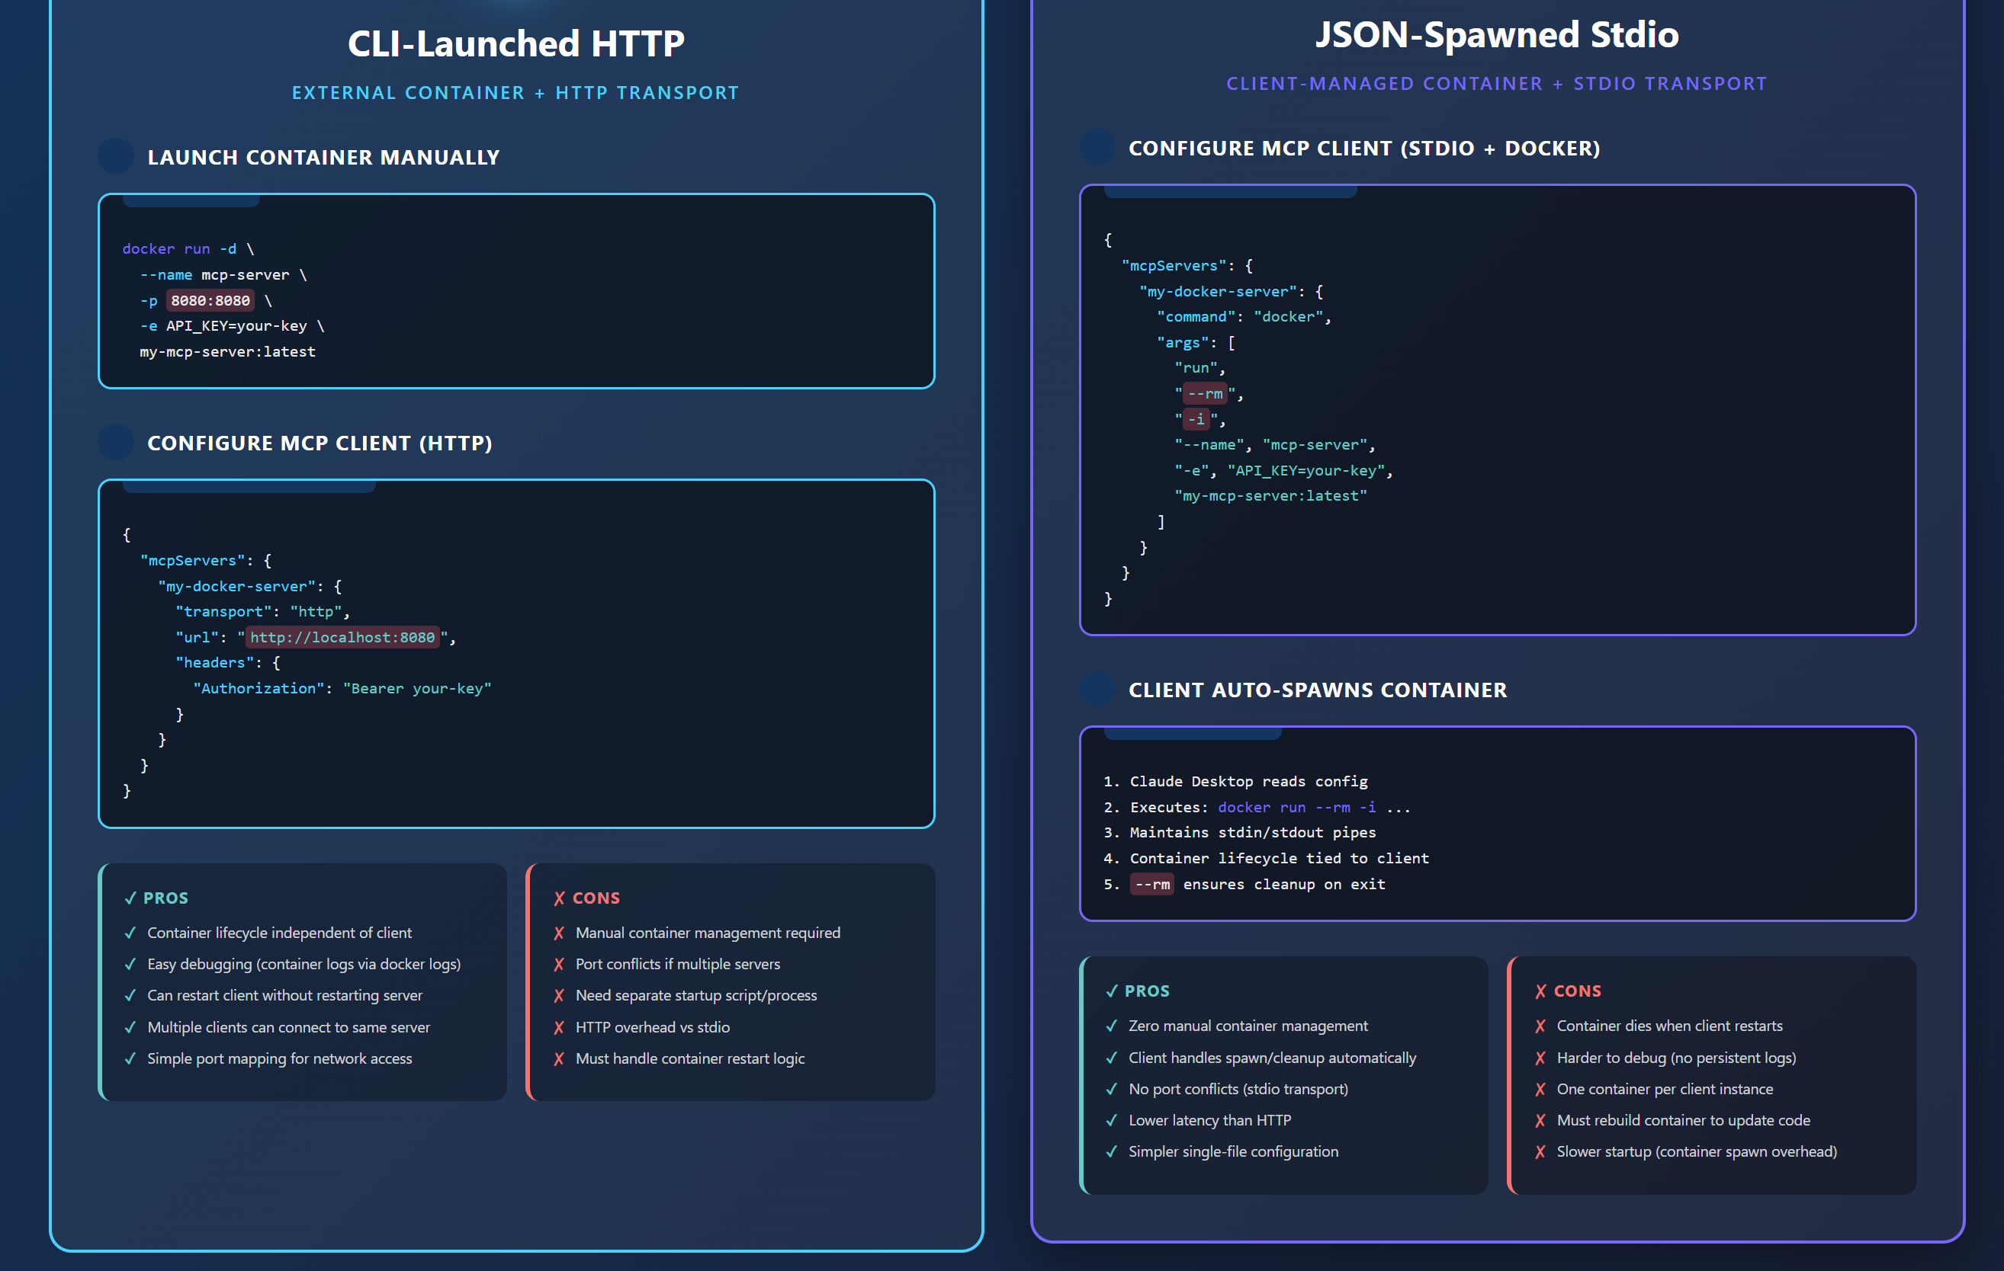
Docker MCP Local Deploy Patterns

Slide 40
Troubleshooting Common Issues
❌ Server Not Showing in Claude
⚠️ stdio: Command Not Found
• Check config file path is correct
• Verify JSON syntax is valid
• Restart Claude Desktop completely
• Use absolute path to server.js
• Ensure Node.js is in system PATH
• Check file permissions
🌐 HTTP: Connection Failed
🔧 Tool/Resource Not Working
• Verify server is running (npm run start:http)
• Check port 3000 is available
• Confirm URL in config matches server
• Check server logs for errors
• Verify handler names match exactly
• Test with simple prompts first

Slide 41
🎯 Next Steps: Level Up Your MCP Server
🗄️
📚
🔐
Add More Tools
More Resources
Add Authentication
File operations, API calls, calculations
Multiple files, database queries, external data
API keys, OAuth, user validation
⚡
📦
☁️
Error Handling
Package & Share
Deploy to Cloud
Robust try-catch, logging, user-friendly errors
Publish to npm, share with team, document usage
Railway, Vercel, AWS for production HTTP access

Slide 42
📚 Resources & Quick Reference
🔗 Official Resources
⚡ Quick Commands
• MCP Documentation
modelcontextprotocol.io
• SDK on GitHub
github.com/modelcontextprotocol
• Example Servers
github.com/modelcontextprotocol/servers
# Run stdio (local)
npm start
# Run HTTP (network)
npm run start:http
# Development mode
npm run dev
✅ What You've Built Today
A complete MCP server with dual transport support (stdio for local dev, HTTP for network access), one working tool (echo), one resource (greeting), and full Claude Desktop integration. You're now ready to build production MCP servers!

Slide 43
🎉 Congratulations!
You've Built Your First MCP Server
TechTrainerTim.com | Microsoft MVP O'Reilly Learning Platform

Slide 44
🧠 AI Memory Architecture
Building Production Context Systems
O'Reilly Learning Platform

Slide 45
Complete Memory System Architecture
Claude
ChatGPT
Copilot
MCP Protocol Layer
📚 Episodic
💡 Semantic
⚡ Working
Cosmos DB
(Time-series)
AI Search
(Vectors)
Redis
(Cache)

Slide 46
☁️ Azure Deployment
From Local to Cloud-Scale Production
O'Reilly Learning Platform

Slide 47
Production Azure Architecture
🌐
🔐
🗄️
App Service
Key Vault
Cosmos DB
Host MCP servers with auto-scaling
Secure secrets & API keys
Global distributed database
🔍
📊
⚡
AI Search
App Insights
Redis Cache
Vector search & RAG
Monitoring & diagnostics
Fast in-memory storage

Slide 48
CI/CD Deployment Pipeline
1
2
3
4
5
Code
Commit
Build
& Test
Container
Build
Deploy
to Azure
Health
Check
→
→
→
→
Push to
GitHub
GitHub
Actions
Docker
Image
App
Service
Smoke
Tests

Slide 49
🔐 Security & Authentication
Protecting Your MCP Infrastructure
O'Reilly Learning Platform

Slide 50
Defense in Depth: Security Layers
Layer 1
Network Security
• Azure Virtual Network
• Private endpoints
• Firewall rules
• DDoS protection
Layer 2
Identity & Access
• Azure AD integration
• OAuth 2.0 flows
• API key management
• RBAC policies
Layer 3
Application Security
• Input validation
• Rate limiting
• CORS policies
• Request logging
Layer 4
Data Protection
• Encryption at rest
• TLS in transit
• Key Vault secrets
• Data masking

Slide 51
🔍 Testing & Debugging
MCP Inspector and Development Tools
O'Reilly Learning Platform

Slide 52
Testing with MCP Inspector
1
Launch Inspector
npx @modelcontextprotocol/inspector
Opens browser-based test interface
2
Connect Server
node server.js
Point Inspector to your MCP server
3
Test Tools
Call tool functions with test inputs
Validate tool responses & errors
4
Test Resources
Read resources & verify content
Check URIs and data format

Slide 53
🤖 Multi-Agent Orchestration
Claude + ChatGPT + Copilot Working Together
O'Reilly Learning Platform

Slide 54
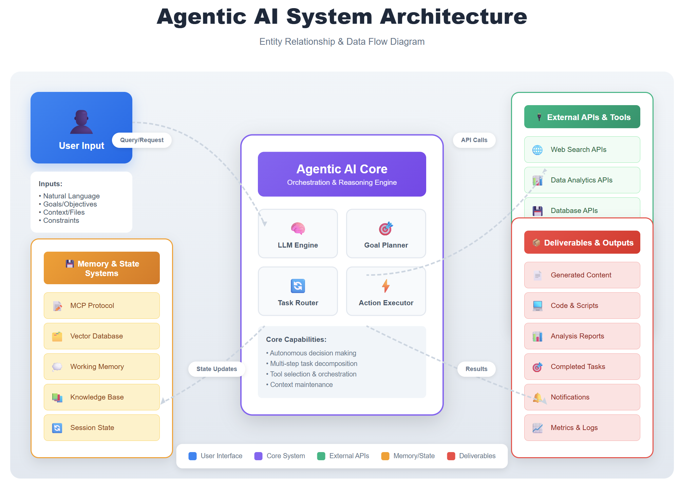

Slide 55
Multi-Agent Memory Sharing Architecture
🤖
Claude
💬
ChatGPT
Shared MCP
Memory Layer
👨‍💻
Copilot
🔧
Custom
Agent

Slide 56
Real-World Multi-Agent Scenario
📋 Scenario: Azure Course Development Pipeline
All agents share the same MCP memory of your course outline, student feedback, and code examples
🤖 Claude
💬 ChatGPT
👨‍💻 Copilot
Content Creation
Research & Analysis
Code Examples
• Write course modules
• Create exercises
• Generate assessments
• Review student work
• Web research
• Trend analysis
• Competitor review
• Market insights
• Write demo code
• Generate tests
• Debug issues
• Document APIs

Slide 57
📊 Production Monitoring
Observability and Performance Tracking
O'Reilly Learning Platform

Slide 58
Application Insights Dashboard
⏱️
🔄
❌
Response Time
Request Rate
Error Rate
< 500ms
1.2K/min
0.3%
Good
Normal
Low
💾
📊
👥
Memory Usage
Token Usage
Active Users
78%
45K/hr
324
OK
Efficient
Active

Slide 59
Thank you!
Course materials: timw.info/context
Contact: TechTrainerTim.com

Slide 60

Context Engineering
for LLM Applications with MCP
The skill that separates toy demos from production-grade AI systems
Tim Warner
Microsoft MVP • TechTrainerTim.com
Notes:
Welcome everyone! Today we're diving into context engineering - the skill that separates toy demos from production-grade AI systems. This isn't just prompt engineering with a fancy name. Context engineering is about building entire information architectures around your LLMs. By the end of this session, you'll understand the four canonical patterns and be ready to implement them in your own projects.

Slide 61

The Core Problem
LLMs are stateless by design. Every API call starts fresh with zero memory of what happened before.
THE CONSEQUENCE
THE DEFINITION
Context windows have hard limits
Long-running agents accumulate massive histories
Performance degrades even before limits
Not all history is relevant to the current task
"Context engineering is the delicate art and science of filling the context window with just the right information for the next step."
— Andrej Karpathy
Cognizant Engineer Training • Context Engineering
Notes:
Here's the fundamental problem: LLMs are stateless by design. Every API call starts completely fresh. The only "memory" an LLM has is what YOU put in the context window. But context windows have hard limits - 200K tokens for Claude, 128K for GPT-4. And even before you hit those limits, performance degrades. Karpathy nailed the definition: it's about filling the window with "just the right information for the next step."

Slide 62
The Mental Model: LLM as Operating System
TRADITIONAL COMPUTER
LLM SYSTEM
CPU
Processing unit
LLM
The model itself
RAM
Limited working memory
→
CTX
WIN
Context window (limited!)
DISK
Persistent storage
MEM
DB
External memory stores
OS
Manages what loads into RAM
YOU
Context engineering layer
Cognizant Engineer Training • Context Engineering
Notes:
This mental model is crucial for understanding context engineering. Think of it like an operating system. The OS decides what gets loaded into RAM for the CPU to process. Similarly, YOUR context engineering layer decides what gets loaded into the context window for the LLM to process. The LLM is the CPU - the processing unit. The context window is RAM - limited working memory. External memory stores are like disk - persistent, larger, slower. And YOU are the operating system.

Slide 63




The Four Canonical Patterns
PATTERN 1
PATTERN 2
PATTERN 3
PATTERN 4
WRITE
SELECT
COMPRESS
ISOLATE
Save context outside the window to external storage for later retrieval.
Pull relevant context back into the window when needed.
Reduce tokens while retaining essential meaning and signal.
Keep contexts separate until specifically needed.
→ Memory stores, vector DBs, scratchpads
→ RAG, semantic search, memory retrieval
→ Summarization, trimming, auto-compact
→ State boundaries, sandboxing, multi-agent
Cognizant Engineer Training • Context Engineering
Notes:
LangChain and the broader community have converged on these four patterns. They're like design patterns in software engineering - proven approaches to common problems. WRITE: Save context outside the window to external storage. SELECT: Pull relevant context back in when needed. COMPRESS: Reduce tokens while retaining essential meaning. ISOLATE: Keep contexts separate until specifically needed. Let's dive into each one.

Slide 64
PATTERN 1
WRITE: Persist Context Outside the Window
WHY WRITE EXTERNALLY?
HOW IT WORKS
Infinite Capacity
Context Window
→
Extract
Context windows max at ~200K tokens. External stores have no practical limit.
Conversation, facts, results
Key facts/results
↓
Session Persistence
Context survives across conversations and restarts.
Vector DB
KV Store
Scratchpad
Semantic Search
Pinecone, Weaviate
Redis, DynamoDB
Files, State
Embeddings enable finding related context by meaning, not just keywords.
Cost Efficiency
External Memory Store — Infinite capacity, persistent across sessions
Don't pay to process the same context repeatedly.
Cognizant Engineer Training • Context Engineering
Notes:
WRITE is about persisting context externally. Why? Context windows max out at around 200K tokens. External stores have no practical limit. In production, you'd use vector databases like Pinecone or Weaviate for semantic search, key-value stores like Redis for fast lookup, or even simple files as scratchpads. The key insight: you're building a memory system that transcends individual conversations.

Slide 65
PATTERN 2
SELECT: Retrieve Relevant Context
TWO RETRIEVAL APPROACHES (GOOGLE ADK PATTERN)
Reactive Recall
Proactive Recall
"Agent asks when it needs to know"
"System pre-fetches before the LLM sees query"
1
Agent recognizes knowledge gap
1
User query arrives
2
Calls load_memory_tool
2
Pre-processor runs similarity search
3
Searches memory corpus
3
Injects snippets via preload_memory_tool
4
Injects result into context
4
LLM sees enriched context
Pro: Agent controls what it needs
Pro: No tool-call latency, automatic
Con: Requires tool-calling capability
Con: May inject irrelevant context
Cognizant Engineer Training • Context Engineering
Notes:
SELECT is the complement to WRITE - it's about retrieval. Google's ADK framework identifies two approaches: Reactive recall: The agent explicitly asks for information when it recognizes a knowledge gap. It calls a tool like load_memory_tool. Proactive recall: The system automatically runs similarity search on the user's input BEFORE the LLM even sees the query, pre-injecting likely-relevant context. Most production systems use proactive recall because it eliminates the latency of an extra tool call.

Slide 66
PATTERN 3
COMPRESS: Reduce Tokens, Retain Meaning
COMPRESSION STRATEGIES
Recursive Summarization
WHY COMPRESS?
📚
Summaries of summaries for compact hierarchies.
💰 Cost Scales with Tokens
Every token costs money.
Hierarchical Summarization
🐌 Latency Increases
🏛️
More tokens = longer processing.
Multiple abstraction levels for navigation and execution.
📉 Context Rot
Targeted Summarization
Performance degrades even within limits.
🎯
Compress specific sections like verbose API responses.
Claude Code: Auto-compact at 95%
Context Trimming
✂️
Drop oldest messages, filter by importance.
Cognizant Engineer Training • Context Engineering
Notes:
COMPRESS is critical because longer contexts cost more, take longer to process, and can actually HURT performance. Claude Code triggers "auto-compact" at 95% context capacity - it summarizes the entire trajectory. You have multiple strategies: recursive summarization creates summaries of summaries. Hierarchical gives you different abstraction levels. Targeted compression focuses on specific sections like verbose API responses. Don't underestimate simple trimming - sometimes just dropping the oldest N messages is enough.

Slide 67
PATTERN 4
ISOLATE: Keep Contexts Separate
IMPLEMENTATION PATTERNS
THE CONTEXT EXPLOSION PROBLEM
State Schema Isolation
Design state with fields selectively exposed to the LLM:
Single-agent systems struggle with context bloat. Multi-agent systems amplify it.
messages: Message[] // Exposed every turn
scratchpad: string // Exposed when needed
toolResults: Result[] // Isolated until requested
If root agent passes full history to sub-agent...
Root: 50K
→
Sub: 50K+
→
Sub-sub: 50K++
Sandboxed Environments
💥 Context explosion!
Run tools in isolated containers (E2B, Pyodide). Tool outputs stay in sandbox until explicitly pulled into context.
Solution: Isolation boundaries with filtered handoffs
Multi-Agent Boundaries
Pass summaries, not full history. Cognition AI uses fine-tuned summarization models at agent-agent boundaries to reduce token usage during knowledge handoff.
Cognizant Engineer Training • Context Engineering
Notes:
ISOLATE prevents context explosion in multi-agent systems. Here's the nightmare scenario: root agent passes its full 50K token history to a sub-agent. That sub-agent passes 50K+ to its sub-agent. Tokens compound exponentially. Solutions include state schema isolation - design your state with fields that are selectively exposed to the LLM. Sandboxed environments for tool execution. And filtered handoffs at agent boundaries. Cognition AI actually uses fine-tuned summarization models specifically for agent-to-agent knowledge transfer.

Slide 68
Common Failure Modes
🦠
Context Poisoning
🎯
Context Distraction
🌀
Context Confusion
📉
Context Rot
A hallucination gets stored in memory, then retrieved and amplified.
Irrelevant info overwhelms the signal. Model focuses on noise.
Conflicting info leads to unpredictable responses.
Performance degrades as context grows, even within limits.
Fix: Relevance filtering, injection budget
Fix: Validate facts, confidence scores
Fix: Section boundaries, role labels
Fix: Proactive compression, recency
Remember: Consequences of flawed memory strategy only surface over time, making them hard to debug.
Notes:
Let's talk about what can go wrong. Context Poisoning: A hallucination gets stored in memory, then retrieved and amplified later. It's like a virus spreading through your system. Context Distraction: Irrelevant information overwhelms the signal. The model focuses on noise instead of the task. Context Confusion: Conflicting information leads to unpredictable responses. The model doesn't know which source to trust. Context Rot: Performance degrades as context grows, even within limits. More tokens doesn't mean better results. The scary part? These problems often surface gradually over time, making them hard to debug.

Slide 69

The Research Says...
39%
Average performance drop from poor context management
Microsoft & Salesforce Research (2025)
98 → 64
3×
95%
o3 drop when info is sharded
Better tool selection with RAG
Claude auto-compact threshold
Bottom line: Model selection matters less than context quality.
Notes:
Let's look at the research. Microsoft and Salesforce found that poorly managed context causes a 39% average performance drop. That's massive. Even more striking: OpenAI's o3 model dropped from 98.1 to 64.1 when information was "sharded" across multiple turns instead of presented together. Same information, different presentation, dramatic performance difference. Tool selection accuracy improved 3x when using RAG-based tool loading with under 30 tools. The bottom line: the same model with better context engineering outperforms a "smarter" model with poor context.

Slide 70
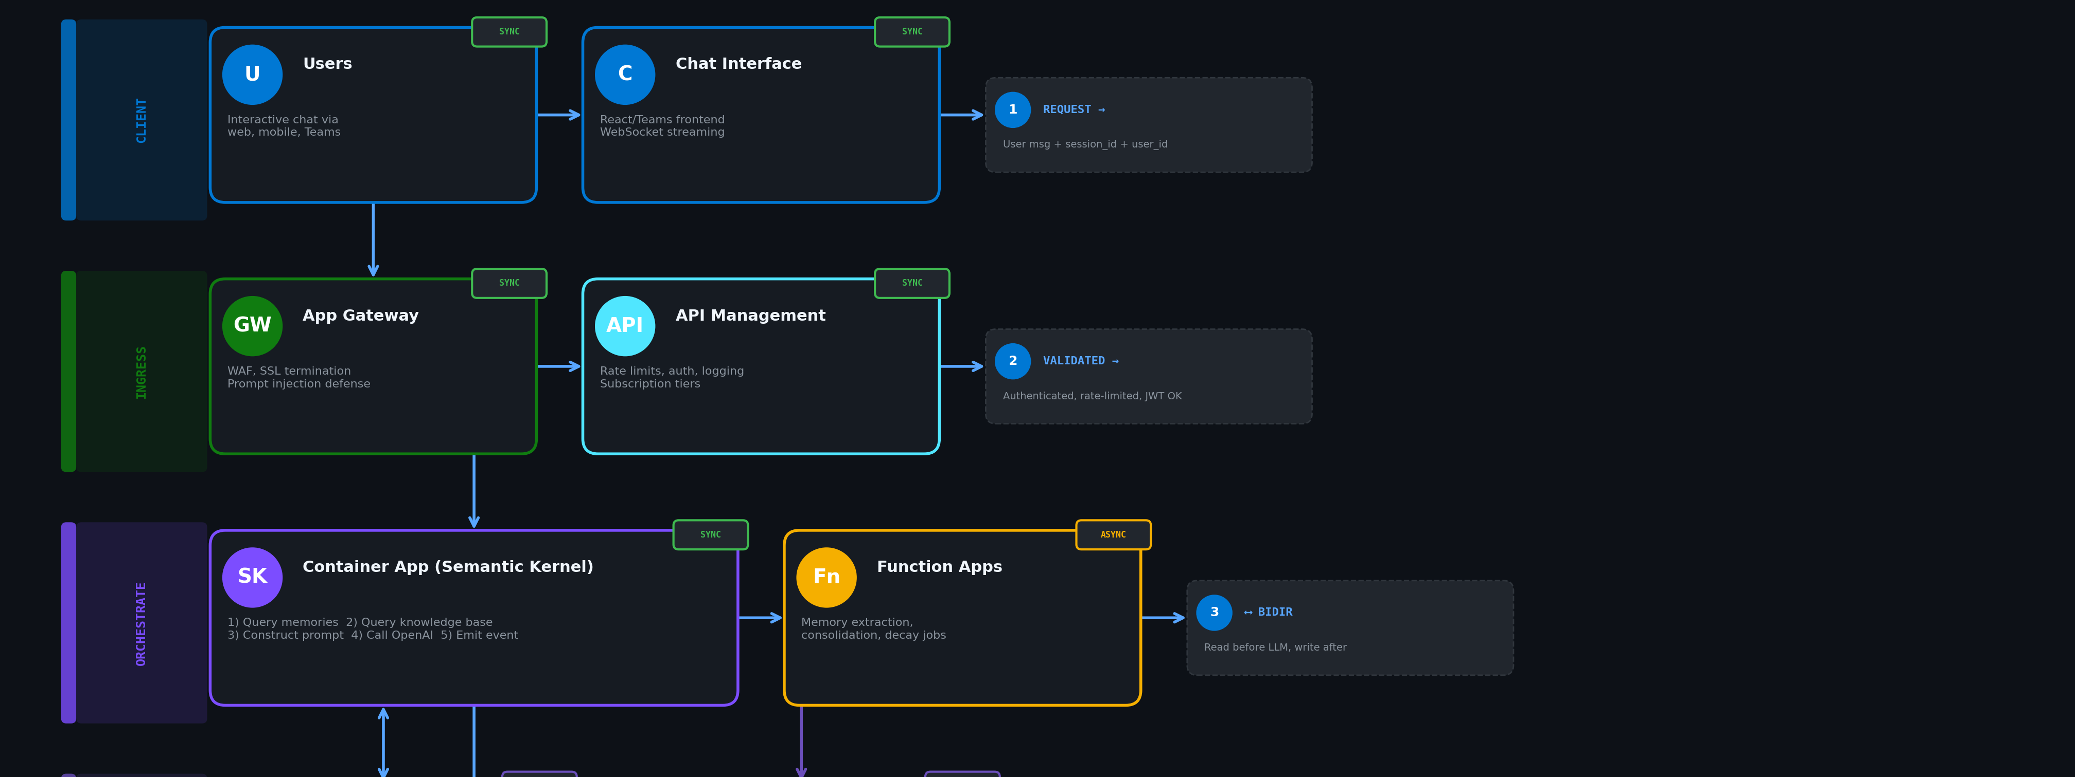
Azure Agentic RAG with Persistent Memory
Notes:
Azure Agentic RAG with Persistent Memory: Complete Walkthrough
This architecture solves a fundamental problem: LLMs have no memory between conversations. Every time a user returns, the model starts fresh. The solution treats memory as a retrieval problem—store what matters in a vector database, fetch it when needed, inject it into the prompt.
Layer 1: Client Layer
Users interact through a Chat Interface (React web app, Teams bot, mobile client—whatever your frontend is). The critical detail here is that the frontend attaches a session_id and user_id to every message. These identifiers are the keys that unlock personalized memory retrieval downstream.
The request flows as a synchronous call—user sends message, waits for response. WebSocket connections enable token-by-token streaming so the response feels immediate rather than waiting for the full completion.
Layer 2: Ingress Layer
Application Gateway sits at the network edge handling WAF (Web Application Firewall) protection and SSL termination. This is your first line of defense against prompt injection attacks—malicious inputs designed to manipulate the LLM. Pattern matching at the gateway can catch obvious attacks before they hit your application logic.
API Management (APIM) handles the business logic of access control: authentication via JWT validation, rate limiting to prevent abuse, request/response logging for observability, and subscription tier enforcement if you're monetizing the API. Every request gets logged here, which becomes invaluable for debugging and compliance.
Both components are synchronous—they're in the critical path of every request. Latency here directly impacts user experience.
Layer 3: Orchestration Layer
This is where the magic happens. The Container App running Semantic Kernel (or LangChain, or your custom orchestration code) executes a five-step sequence for every user message:
Step 1: Query Memories. Before doing anything else, the orchestrator queries the Cosmos DB vector store. It takes the user's current message, generates an embedding, and performs a similarity search filtered by user_id. This returns the top-k most relevant memories from past conversations—facts the user shared, preferences they expressed, decisions they made.
Step 2: Query Knowledge Base. Simultaneously (or sequentially, depending on your implementation), the orchestrator queries AI Search for relevant documents from your RAG knowledge base. This is your product documentation, policy documents, domain expertise—whatever grounding content makes your agent useful.
Step 3: Construct Prompt. The orchestrator assembles the final prompt. The system message now includes injected memories ("User prefers Python over JavaScript, confidence: high") and RAG context ("According to the refund policy document..."). The user's actual message goes in the user turn. The LLM now has full context without ever having "seen" those prior conversations.
Step 4: Call Azure OpenAI. The assembled prompt goes to GPT-4o (or your model of choice). The model generates a response informed by both personal memory and knowledge base grounding.
Step 5: Emit Event. After returning the response to the user, the orchestrator emits an event to a message queue (Service Bus, Event Grid, whatever). This event contains the full conversation turn—user message plus assistant response—and triggers the async memory extraction pipeline.
The Function Apps handle everything that shouldn't block the user's response. They're event-driven and asynchronous:
Memory Extraction: A secondary LLM call analyzes the conversation turn and extracts "memory-worthy" content—facts, preferences, decisions, emotional context
Consolidation: Checks if the new memory duplicates an existing one (semantic similarity > 0.9) and merges if so
Decay Scoring: Nightly jobs recalculate importance scores based on retrieval frequency
Bulk Imports: If a user wants to "tell" the system a bunch of context upfront, Function Apps handle the batch processing
Layer 4: Memory Layer
Two Cosmos DB instances serve distinct purposes:
Cosmos DB (History) stores raw conversation transcripts. Every message, every response, timestamped and linked to session IDs. This is your audit trail, your debugging resource, your compliance record. TTL policies automatically expire old conversations based on your retention requirements.
Cosmos DB (Vectors) stores semantic memories with their embeddings. The schema includes:
FieldPurposeuser_idPartition key for user isolationmemory_typefact, preference, decision, emotional_contextcontentHuman-readable memory textembedding1536-dimension vector (ada-002)confidence0.0-1.0 extraction confidenceimportanceCalculated from retrieval frequencylast_accessedUpdated on each retrieval (enables decay)source_conversation_idLink back to raw transcript
The bidirectional arrow between Container App and Cosmos DB (Vectors) is critical—the orchestrator reads memories before the LLM call, and Function Apps write memories after extraction. This separation keeps the synchronous path fast.
Layer 5: AI Services Layer
AI Search indexes your knowledge base—product docs, policies, domain expertise. It's configured for hybrid search (keyword + vector) to get the best of both retrieval methods. This is separate from user memories; it's shared knowledge that applies to all users.
Azure OpenAI provides two capabilities:
Completion (GPT-4o): Generates responses with injected memory and RAG context
Embeddings (ada-002 or text-embedding-3-large): Converts text to vectors for both memory storage and retrieval queries
Document Intelligence handles the ingestion pipeline for your knowledge base. PDFs and Word docs get OCR'd, chunked into semantic segments, embedded, and indexed into AI Search. This runs asynchronously—you're not blocking user requests while processing a 200-page PDF.
The Complete Request Flow
Let's trace a single user message through the entire system:
User sends: "Can you help me with that Python project we discussed?"
Chat Interface attaches user_id: abc123, session_id: xyz789
App Gateway validates the request, blocks injection patterns
APIM authenticates JWT, checks rate limits, logs request
Container App receives the validated request
Memory Query: Searches Cosmos vectors for "Python project" filtered by user_id: abc123
Retrieved memories: "User is building an MCP server for Stoic philosophy using Python (2024-12-01)", "User prefers explicit type hints in Python code"
Knowledge Query: AI Search returns relevant Python best practices docs
Prompt Assembly: System prompt now includes the memories and RAG context
Azure OpenAI generates response with full context
Response streams back through APIM → Gateway → Chat Interface
Event emitted to Service Bus with conversation turn
Function App triggered: Extracts new memories ("User asked for help with MCP server project")
Memory written to Cosmos with embedding and metadata
Total synchronous latency: ~2-4 seconds (dominated by LLM inference) Async memory write: Happens in background, user doesn't wait
Why This Architecture Works
Unlimited context becomes a retrieval problem, not a token limit problem. You could store millions of memories per user—the constraint becomes retrieval quality, not storage.
Hierarchical memory mimics human cognition. Recent memories stay detailed. Older memories get summarized. Core facts persist indefinitely. The decay function (importance = base_score × 0.95^days_since_accessed) ensures frequently-retrieved memories stay prominent.
Separation of concerns keeps the system maintainable. Synchronous chat path stays fast. Async memory management can be tuned independently. Knowledge base updates don't affect the memory system.
Microsoft-endorsed patterns throughout. Semantic Kernel for orchestration, Cosmos DB for state, AI Search for retrieval, Container Apps for hosting, Function Apps for events. This is textbook Azure architecture.

Slide 71
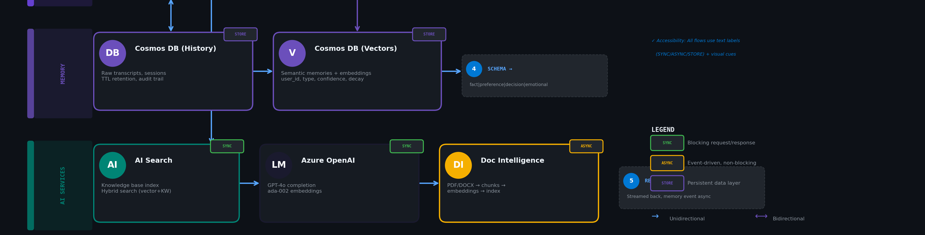
Azure Agentic RAG with Persistent Memory

Slide 72
Key Takeaways for Enterprise Development
Context is your primary lever
Compression is not optional
1
4
Model selection matters less than context quality.
Plan for it from day one. Build auto-compact triggers.
Budget ruthlessly
Observe everything
2
5
Allocate token budgets per section (memories: 10%, history: 20%, etc.)
Track token usage, relevance scores, retrieval quality. Can't improve what you don't measure.
Relevance over recency
Isolation prevents disasters
3
6
The most recent context isn't always the most relevant.
Multi-agent context explosion is real. Design boundaries early.
The Four Patterns: WRITE (persist) → SELECT (retrieve) → COMPRESS (reduce) → ISOLATE (separate)
Cognizant Engineer Training • Context Engineering
Notes:
Let's summarize the key takeaways. First, context is your primary lever. Don't obsess over model selection - focus on context quality. Second, budget ruthlessly. Allocate specific token budgets per section. Third, relevance over recency. The most recent context isn't always the most relevant. Fourth, compression is not optional. Plan for it from day one. Fifth, observe everything. You can't improve what you don't measure. Sixth, isolation prevents disasters. Design boundaries early, especially for multi-agent systems.

